Slide 1

Credit Scoring and Segmentation System
Introduction:
The project aims to build a robust credit scoring and segmentation system using Python. By leveraging machine learning techniques, the system will analyze historical credit data to assess and segment decisions.
customers based on their creditworthiness, enabling financial institutions to make informed lending
JAHNAVI JAMMULA

Slide 2
CRISP-ML(Q) : Cross-Industry Standard Process for Machine Learning with Quality Assurance
Machine Learning Development Life Cycle Process.
Business and Data Understanding
Data Engineering (Data Preparation)
Machine Learning Model Engineering
Quality Assurance for Machine Learning Applications
Deployment
Monitoring and Maintenance.

Slide 3
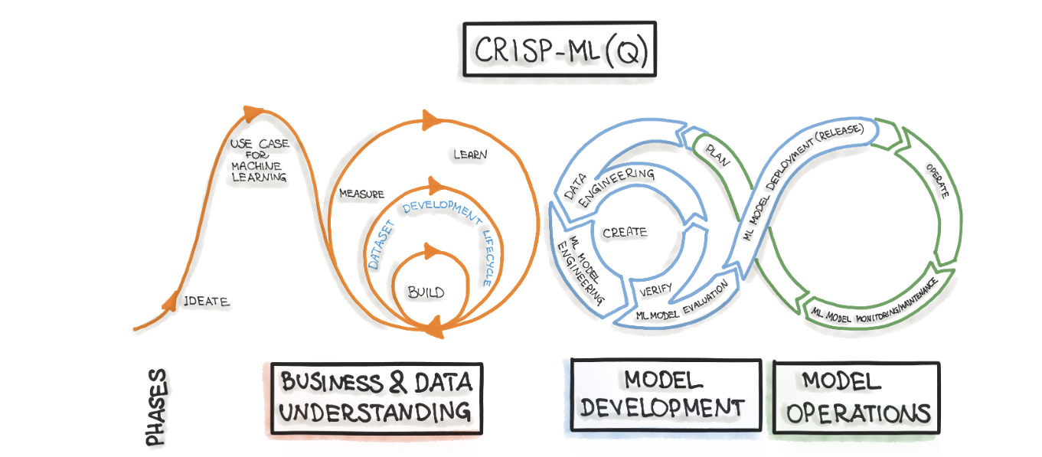
Business understanding :
Gather and preprocess credit data for analysis.
Explore various machine learning algorithms suitable for credit scoring.
Develop a credit scoring model to predict customer creditworthiness.
Implement segmentation techniques to categorize customers based on risk profiles.
Create a user interface for visualizing credit scores and segmentation results

Slide 4

Data understanding
Age: This feature represents the age of the individual.
Gender: This feature captures the gender of the individual.
Marital Status: This feature denotes the marital status of the individual.
Education Level: This feature represents the highest level of education attained by the individual.
Employment Status: This feature indicates the current employment status of the individual.
Credit Utilization Ratio: This feature reflects the ratio of credit used by the individual compared to their total available credit limit.
Payment History: It represents the monthly net payment behavior of each customer, taking into account factors such as on-time payments, late payments, missed payments, and defaults.
Number of Credit Accounts: It represents the count of active credit accounts the person holds.
Loan Amount: It indicates the monetary value of the loan. Interest Rate: This feature represents the interest rate associated with the loan.
Loan Term: This feature denotes the duration or term of the loan. Type of Loan: It includes categories like “Personal Loan,” “Auto Loan,” or potentially other types of loans

Slide 5
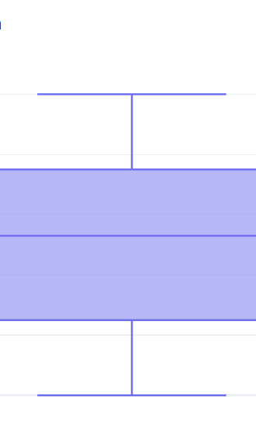
visualizations
Visualization clearly shows that there is no outliers and data is distributed normally like with out skewed data this is called normal distribution.
Central Tendency:
The mean, median, and mode are all equal in a perfectly normal distribution.
Bell-shaped Curve:
The distribution forms a bell-shaped curve, with the majority of the data clustered around the mean.
Symmetry:
Normal distribution is symmetric, meaning that the data is evenly distributed around the mean.
Skewness and Kurtosis:
Skewness (measure of asymmetry) and kurtosis (measure of tailness) are both close to zero in a perfectly normal distribution.

Slide 6
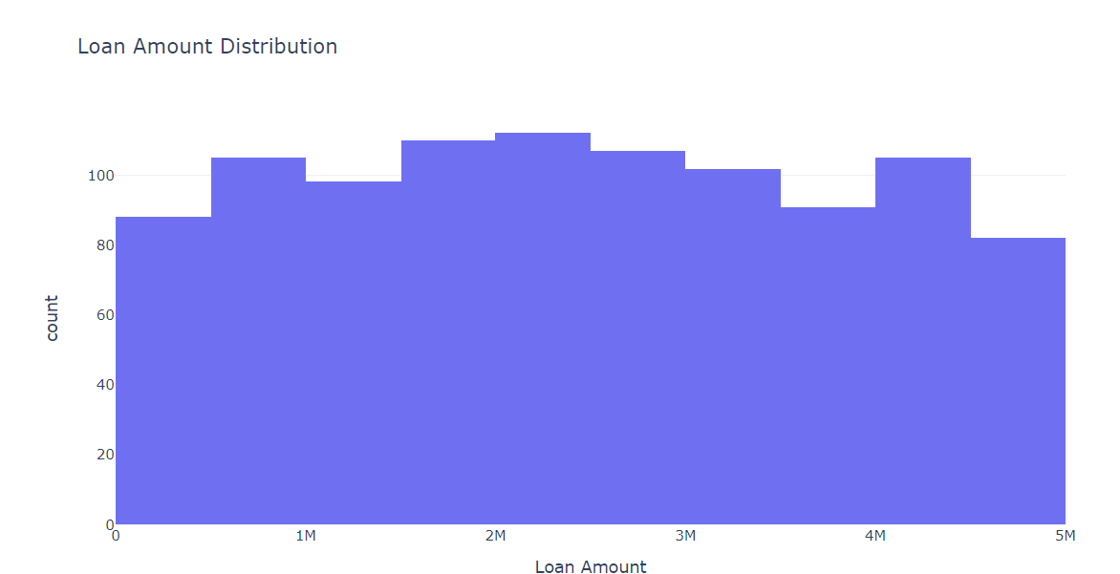
Loan Amount distribution

Slide 7
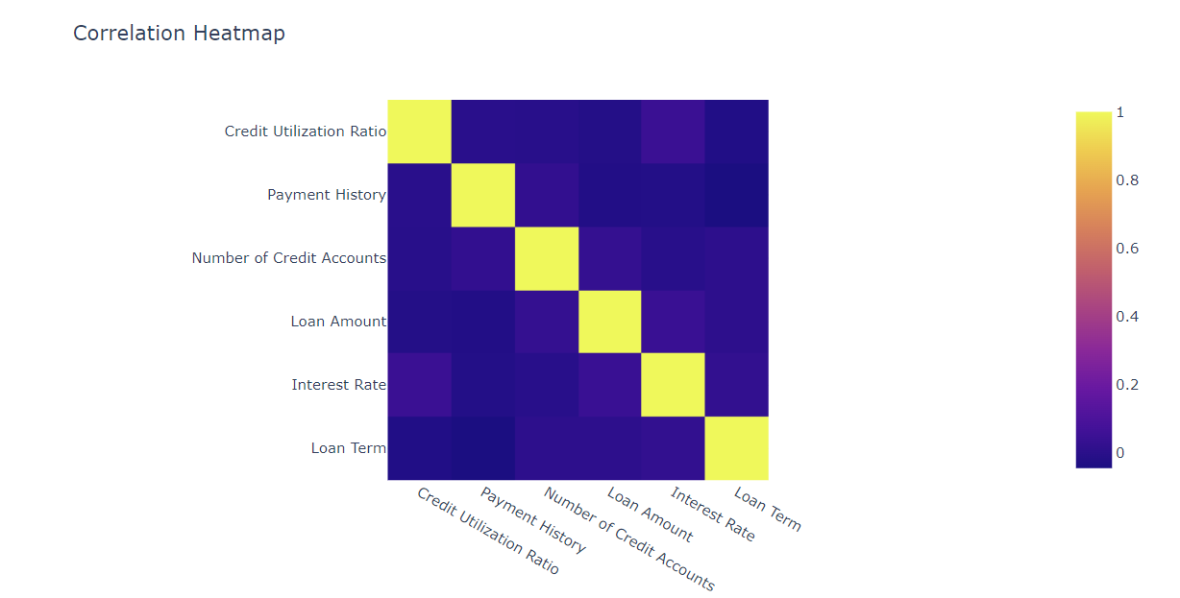
Heat map correlation between variables

Slide 8

K means clustering Algorithm
K-means clustering is and its purpose in data analysis.
Clearly state why K-means clustering was chosen for this credit scoring and segmentation project.
Data preprocessing steps taken before applying K-means.
The process of selecting the optimal number of clusters for your credit segmentation.
Here we have taken 4 clusters and we divided in to 4 clusters
To divide in to clusters we have used elbow technique
credit segmentation derived from K-means clustering can influence decision-making in the financial context.

Slide 9
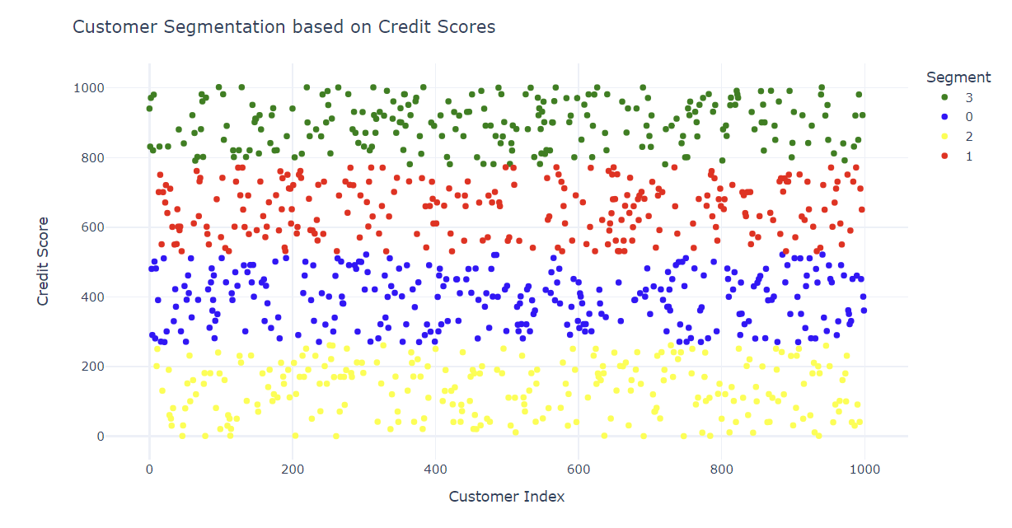
Clusters Finally, after applying the k means algorithm, we divided in to 4 clusters

Slide 10
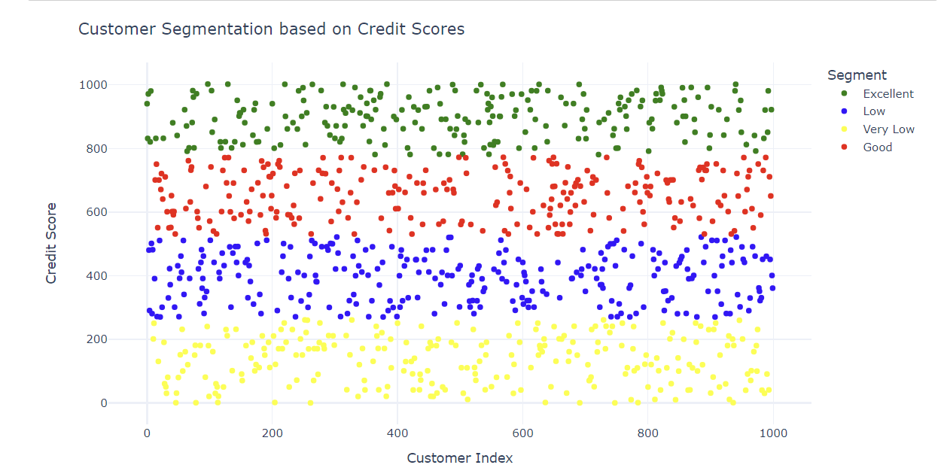
Finally, we have given here segments which one is the best

Slide 11

Conclusion
The Credit Scoring and Segmentation System project emerges as a robust and transformative solution, leveraging advanced machine learning methodologies to enhance decision-making processes within financial institutions. The meticulous data collection and preprocessing procedures ensure the reliability of historical credit data, paving the way for feature engineering strategies that contribute to the precision of the credit scoring model. Through the exploration of various machine learning algorithms, rigorous evaluation, and careful model selection, the project attains a credit scoring model aligned with the goal of providing accurate and reliable assessments of customer creditworthiness. Furthermore, the incorporation of clustering techniques for customer segmentation, coupled with a user-friendly interface, empowers financial professionals to gain valuable insights into credit risk profiles, fostering a streamlined decision-making process. The commitment to transparency through comprehensive deliverables, including documentation, trained models, and codebase, underscores the project's dedication to advancing data-driven decisions and contributing to the overall stability and efficiency of financial institutions

